Slide 1
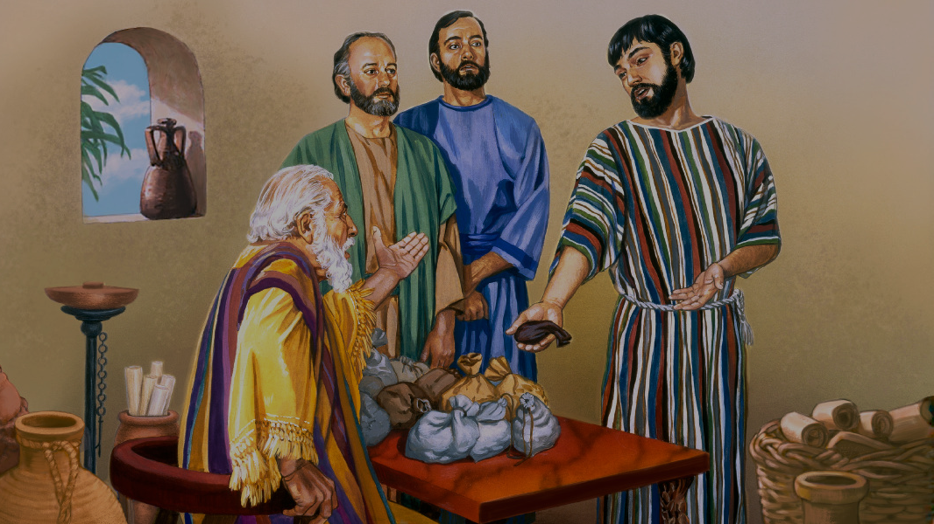
DEVOTION FAITHFULNESS IN LITTLE THINGS
KEY TEXT: LUKE 19:17

Slide 2
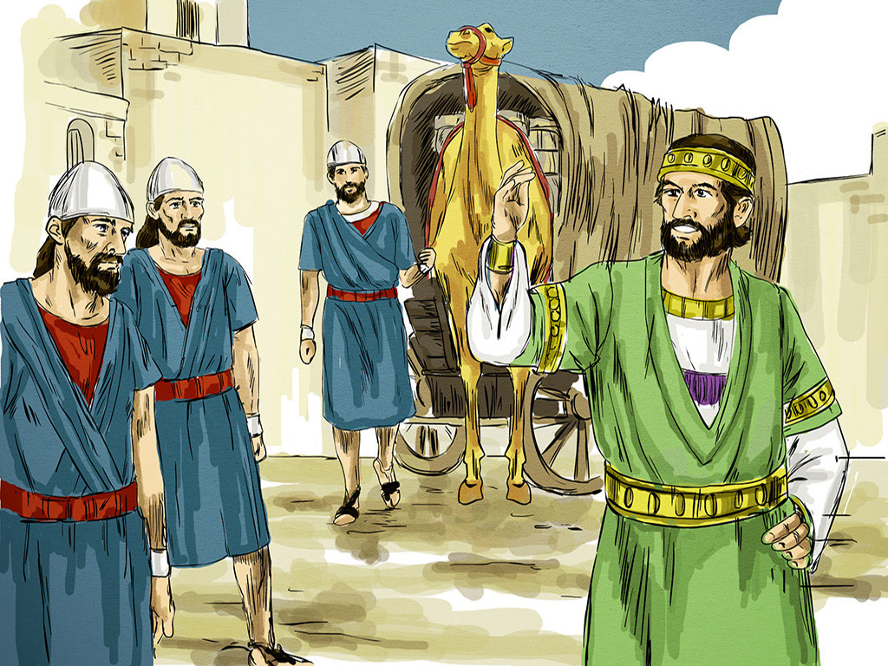
Introduction
A nobleman goes to receive a kingdom and entrusts his ten servants with a mina each, instructing them to do business until he returns.
Notes:
The Bible teaches us that faithfulness in small things is crucial for greater responsibilities. In Luke 19:11–27, Jesus shares the parable of the minas

Slide 3
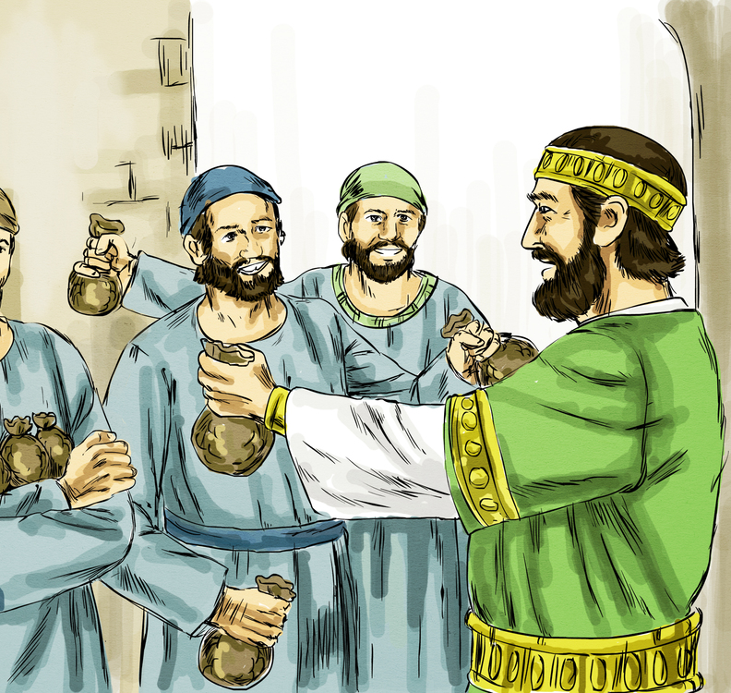
Upon his return, he assesses how each servant handled what was entrusted to them.
The ones who were faithful and productive with little were rewarded with greater responsibility: "Well done, good servant! Because you have been faithful in a very little thing, have authority over ten cities"

Slide 4

This parable teaches us the importance of faithful stewardship and accountability.
Jesus used it to correct the misconception that the Kingdom of God would appear immediately and to teach that in His physical absence, His followers must diligently carry out their duties.

Slide 5
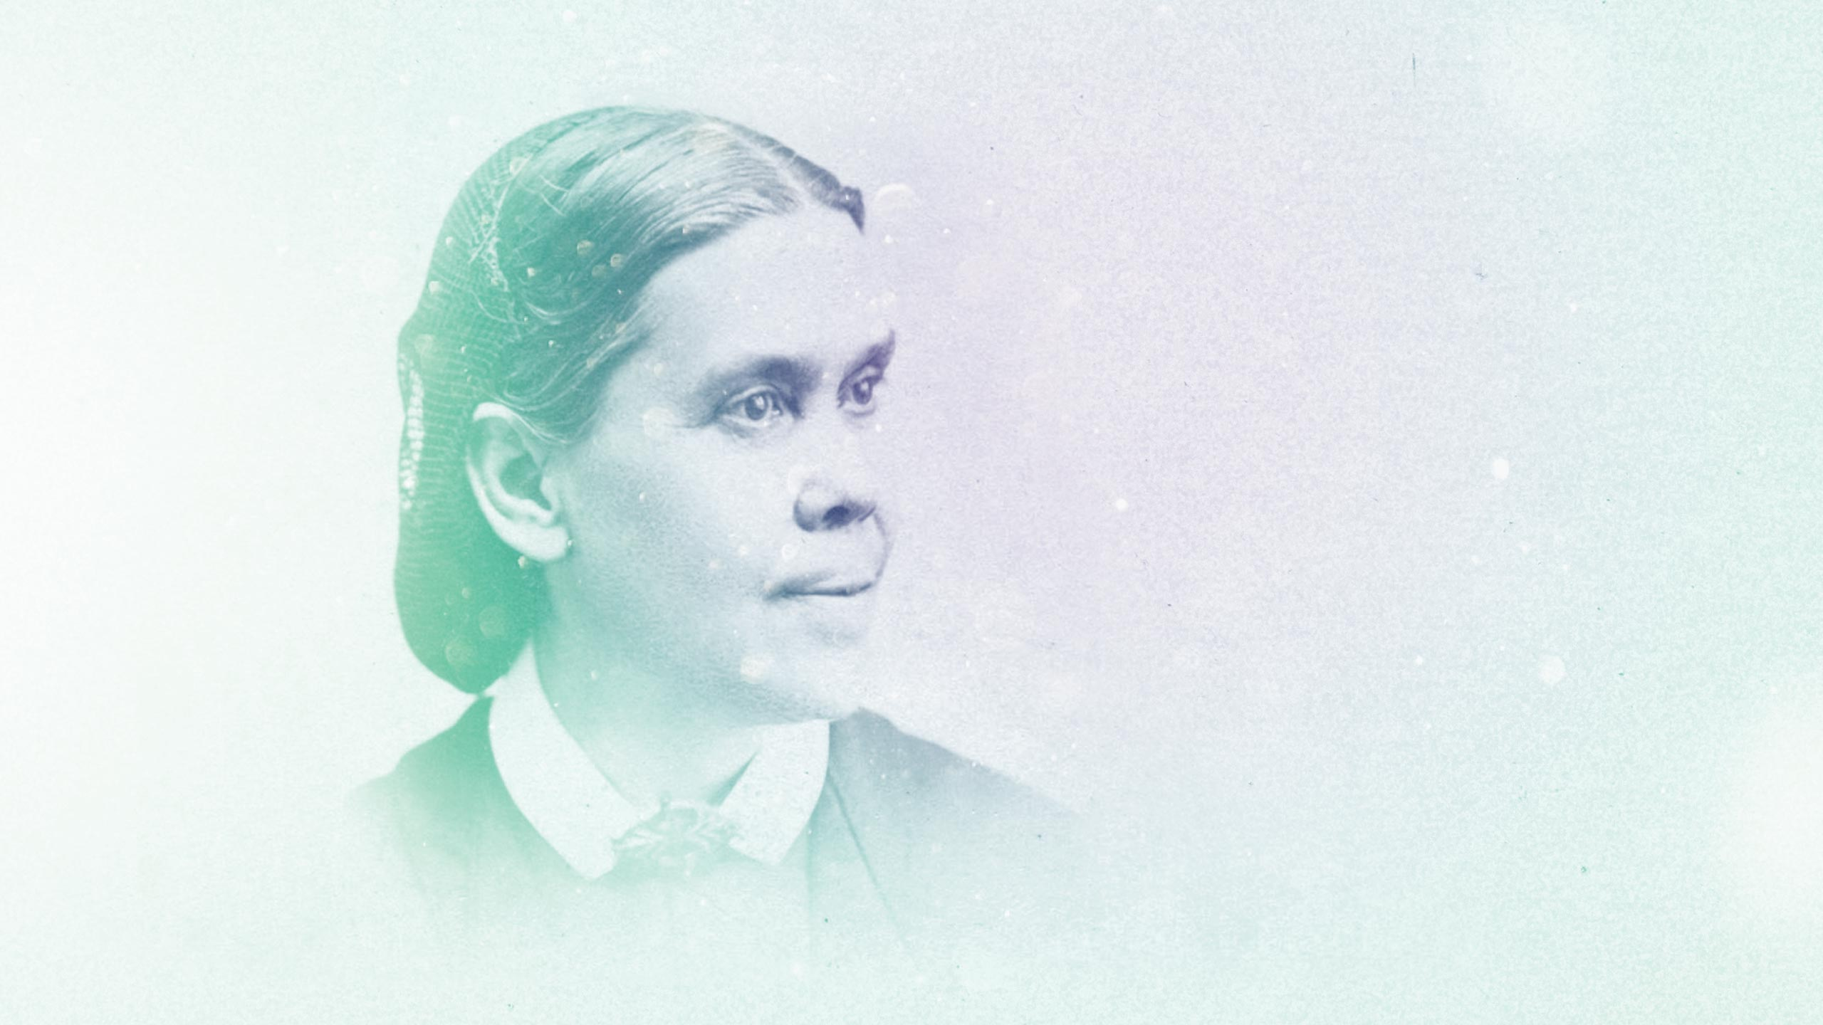
"In a thousand ways you may serve the Lord. By performing the lesser duties, you are preparing yourself for greater responsibilities."
(Christ's Object Lessons, p. 355)
Notes:
As Ellen G. White notes, "In a thousand ways you may serve the Lord. By performing the lesser duties, you are preparing yourself for greater responsibilities." (Christ's Object Lessons, p. 355)Faithfulness in small matters demonstrates our trustworthiness and prepares us for greater responsibilities in God's kingdom.

Slide 6
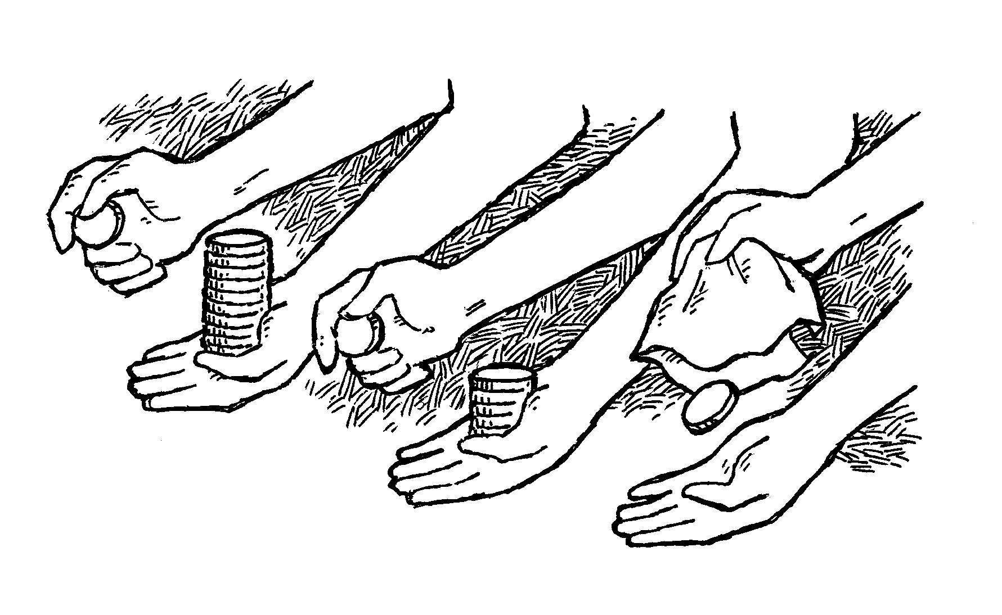
The Parable in Luke 19:11–27

Slide 7
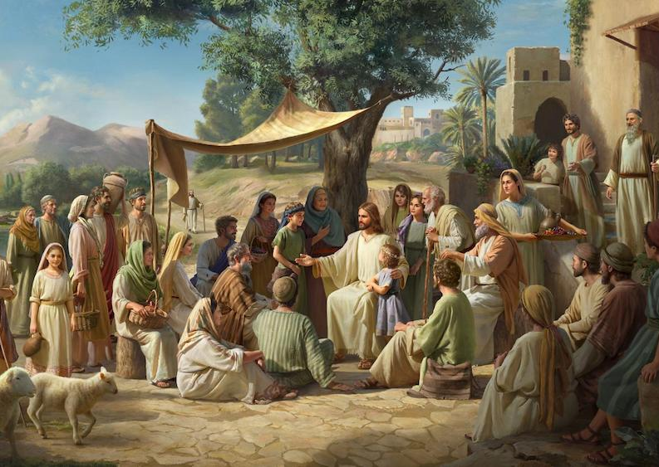
Jesus told this parable as He approached Jerusalem, after encountering Zacchaaeus in Jericho.
His listeners expected the immediate establishment of God’s kingdom (Luke 19:11).
Let’s retell the story.

Slide 8
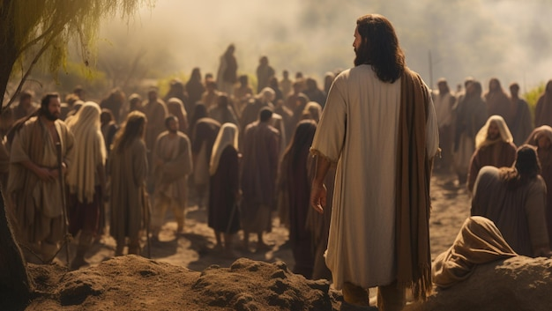
Why Jesus Told It?

Slide 9
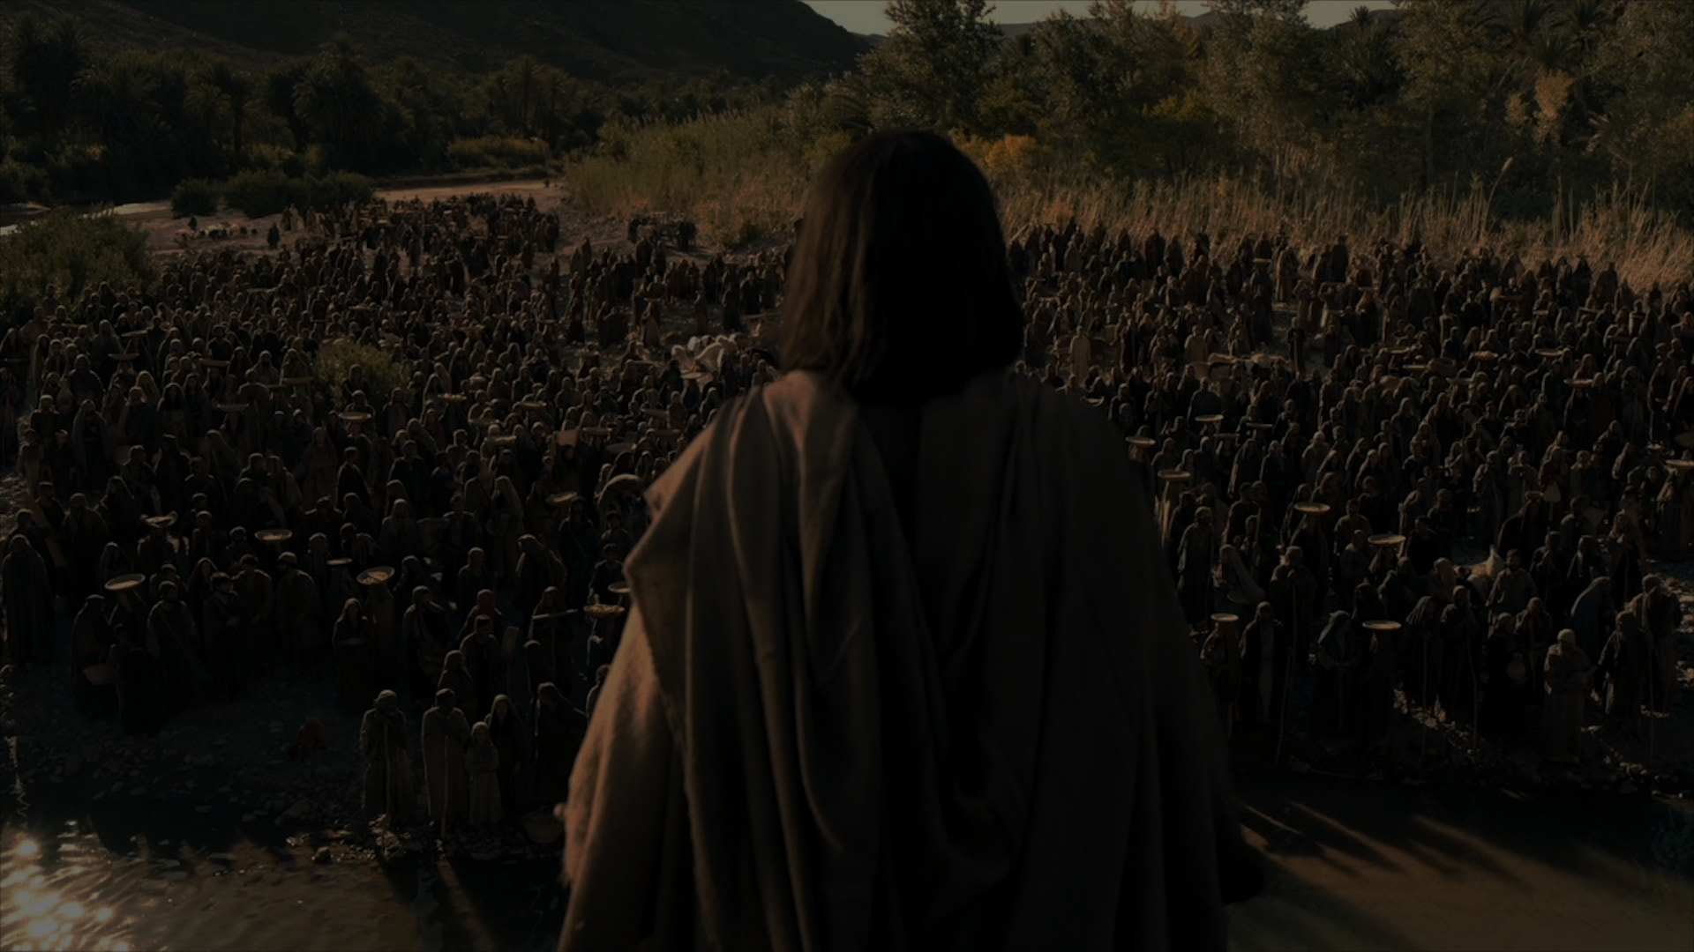
Why Jesus told it?
To correct false expectations
To emphasize responsibility
To teach accountability
To reveal reward and consequence
Notes:
To correct false expectations – The people thought the kingdom of God would appear immediately.
To emphasize responsibility – While waiting for Christ’s return, His followers are to faithfully work with what they’ve been given.
To teach accountability – Everyone will give an account of their stewardship.
To reveal reward and consequence – Faithfulness is rewarded with greater trust; neglect, laziness and idleness, are punished.

Slide 10
Importance of Faithfulness in Little Things
Demonstrates Trustworthiness
Prepares for Greater Responsibilities
Builds Character and Integrity
Notes:
Demonstrates Trustworthiness: Faithfulness in small matters shows our commitment to God's principles and our trustworthiness. As Jesus said, "Whoever is faithful in very little will also be faithful in much, and whoever is unrighteous in very little will also be unrighteous in much." (Luke 16:10)
Prepares for Greater Responsibilities: Being faithful in little things prepares us for greater responsibilities and opportunities in God's kingdom. EG White writes, "The faithful performance of today’s duties is the best preparation for the trials of tomorrow." (Messages to Young People, p. 200)
Builds Character and Integrity: notice that greatness of men is often hidden in their obscure and humble beginnings. What matters most is not the size of your start but the spirit of your faithfulness and the little things you put in towards the accomplishment of your dream.

Slide 11
Practical Applications
Time Management
Finances
Relationships
(Galatians 6:10)
Accept little responsibilities
Notes:
Time Management: Being faithful in managing our time wisely demonstrates our commitment to God's priorities. As C.S. Lewis noted, "You don't have a soul. You are a Soul. You have a body." Prioritizing our time according to God's priorities is essential.
Finances: Faithfulness in tithing and giving demonstrates our trust in God's provision and care. Malachi 3:10 encourages us to "Bring the full tithe into the storehouse, that there may be food in my house."
Relationships: Faithfulness in nurturing relationships with family, friends, and church community reflects our love for God and others. As Paul wrote, "Let us do good to everyone, and especially to those who are of the household of faith." (Galatians 6:10)
Accept little responsibilities: Accepting little responsibilities prepare you for bigger ones. Little responsibilities also prepare you to face and overcome more challenging tasks.
When we had just one semester to finish our first degree at KNUST, it became almost a ritual for the lecturers in our department to use the first ten minutes of their lecture time to advice us. Most of the advice they gave us centered on how we could face the challenges of life after school. Dr D.N.A. Hammond, the head of the Land Economy Department, who had taught us Principles of Law in our first year and was handling us in Property Valuation in the final year, briefly shared with us the value of accepting little responsibilities.As he spoke to us, he paused and started gazing intently through the window for a couple of minutes. It suggested to us that he was recollecting something. He turned back to us and told us that some years back he used to run errands for some of the lecturers including the then head of department. Because of his exceptional academic performance, he was asked to work as a Teaching Assistant when he finished his course of study. According to him, he could climb and descend the stairs more than twenty times in a day, picking up files for the lecturers and performing other tasks that were assigned him. Such little responsibilities were preparing him for bigger and more rewarding ones—he rose through the ranks to become the head of that department!
Remember: Accepting little responsibilities prepare you for bigger and more rewarding ones.

Slide 12
Why Did Jesus Mention Only Three Servants?
Representative Teaching.
Emphasis by Contrast.
Invitation to Reflect.
Notes:
In the parable, a nobleman gives ten servants one mina each. Yet, Jesus only describes the actions of three servants in detail. (I read the story several times and upon reflection I noticed this!). Why did Jesus mention only three servants?
Representative Teaching: Jesus uses three examples to reflect the full range of human responses to responsibility—one servant who multiplies greatly, one who does moderately well, and one who fails completely.
Emphasis by Contrast: By showing the best, the average, and the worst, Jesus makes His lesson clear and impactful.
Invitation to Reflect: The other seven servants are not named—leaving space for each of us to ask: “Which of the ten am I?”
Key Insight:The rest of the story is still being written—through our own faithfulness or neglect. We are part of this parable.

Slide 13

Conclusion
Faithfulness in little things is a hallmark of a true disciple of Christ. As we strive to be faithful in small matters, we demonstrate our trustworthiness and prepare ourselves for greater responsibilities in God's kingdom.

Slide 14
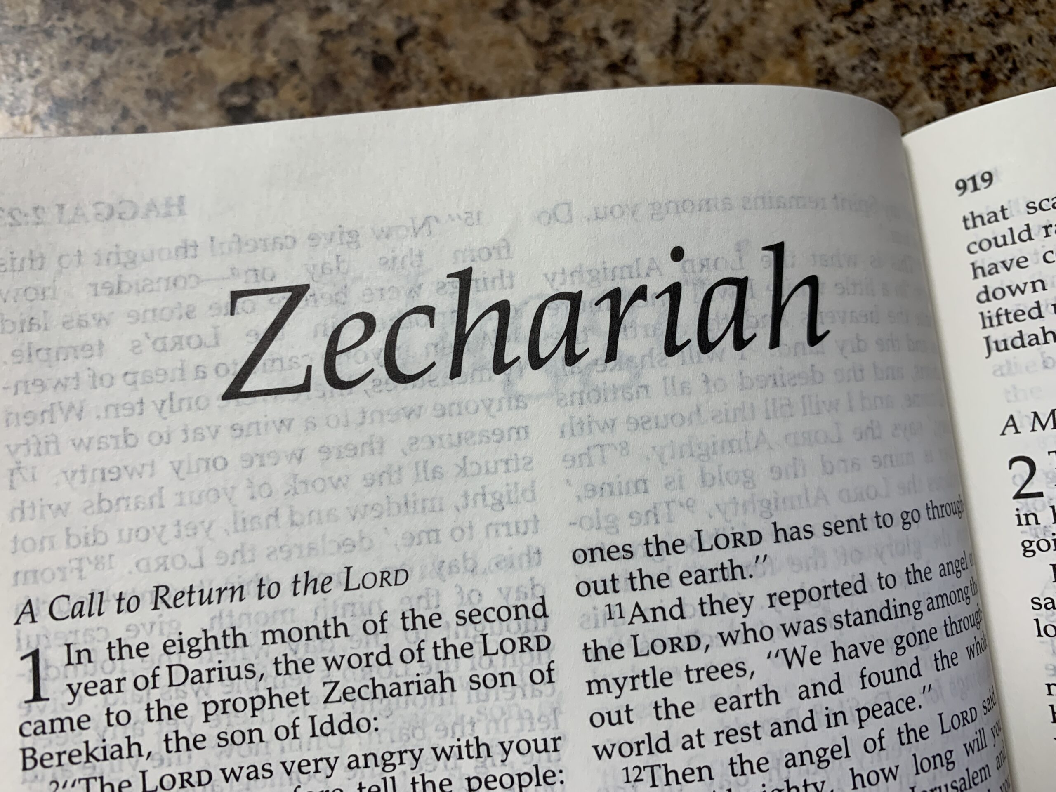
“Do not despise these small beginnings, for the Lord rejoices to see the work begin...” Zechariah 4:10 NLT.

Slide 15
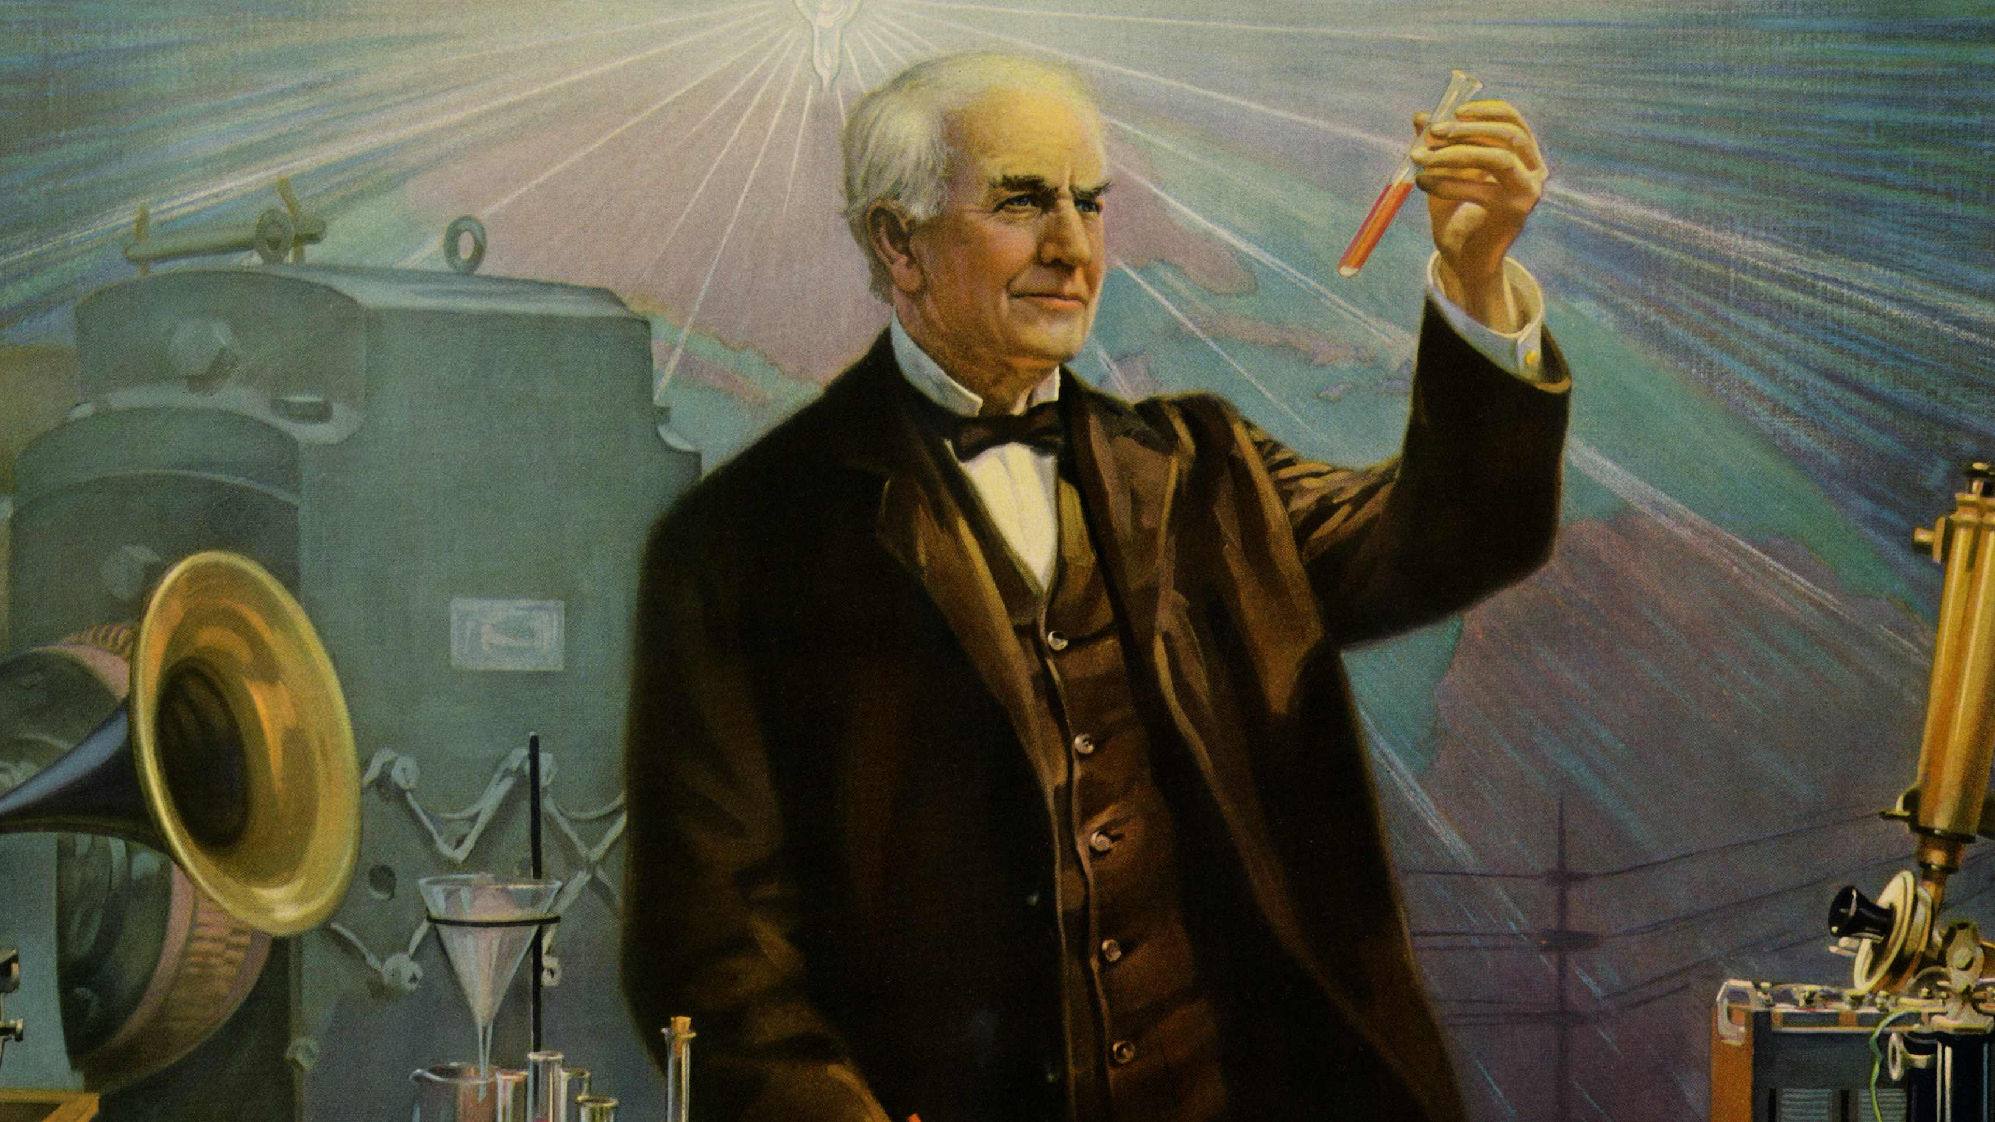
The story of Thomas Edison
Notes:
Let us consider the story of Thomas Edison. As a child, he was labeled as slow and unteachable. But he remained faithful in experimenting, learning, and growing in small ways. Eventually, he became one of the greatest inventors the world has ever known. Faithfulness in little things, —whether it's in study, ministry, or daily devotion—leads to life-changing outcomes.

Slide 16

May we be faithful in little things, trusting that God will entrust us with greater opportunities to serve Him.

